Slide 1
Reduce distortion of USB audio signal on Renault AIVI2
Contents
1. Define
2. Measurement
3. Analyze
4. Improvement
5. Control
6 Sigma GB Assignment
IVI LD1 Nguyen Dinh Hoang Anh

Slide 2
Task category
□ HW ■ SW
□ Mecha □ Current job
Team | IVI LD1
Leader | Nguyen Dinh Huong
Owner | Nguyen Dinh Hoang Anh
Six Sigma Project Register
Theme | Model Renault AIVI2 – Media 2 Station Reduce distortion of USB audio signal on Renault AIVI2 |  |  |  | Period | 2026.09.01~2026.11.10 |  | Task team name | IVI LD1
Six Sigma Project |  | Improvement Goal (Stretch Goal) |  |  |  |  |  | Idea of breaking the limit
 |  | Improvement index |  | Current |  | World Best | Goal
Reduce distortion of USB audio signal on Renault AIVI2 |  | KPI | Reduce defect for this issue (ppm) | 47,091 (ppm) |  | NA | 0ppm | - Change job file sequence to run the USB test before the AUX test; realign and fix the contact level of the Pogo pin with the Pallet. - Change the Audio signal connector type from pogo pin block to PCB and shift the connection direction from vertical to horizontal to reduce force stress.
 |  | Project Y | Spec: 0 ->1.2 | Cpk = 0.68 |  | NA | Cpk ≥1.33
Management Issue (Biz.Issue) |  | Implement Plan (Fast & Strong) |  |  |  |  |  | Task Member
This issue has been around for a long time, and the failure rate is very high at 47,091 ppm, so we waste time to rework and rework fee
 |  |  |  |  |  |  |  | Location
 |  |  |  |  |  |  |  | LG Electronics Viet Nam-Hai Phong
Qualitative Performance |  | Quantitative Performance |  |  |  |  |  | Neck Point
- Improving smoothly testing process for sets - Reducing cost |  | After this theme, I can save loss time: Before defect rate: 47,091 ppm → EST: Loss time and rework fee (42$ - sample price) After defect rate: 0 ppm → Improve issue Total save cost: 42$*1200=50400$ |  |  |  |  |  | Because improvement action related to equipment, so need support from PE team
❑ Schedule
Team | Name | Role
LD1 | Phu | Member
SQA | Hieu | Member
ME | Cuong | Member
PE | Vinh | Member
PD | Hoan | Member
9/1
9/15
9/30
10/12
10/30
D
M
A
I
C
Key activity / Output
D : Define issue, Define defect rate, Collect defective sample
M : Gage R&R evaluate equipment and inspector measurement skills
A : Use Fish bones analysis method to find root cause
I : Meeting discuss, make improvement action plan and follow up
C : Verify action on the line, Set up quality meeting to control this issue
Notes:
2

Slide 3
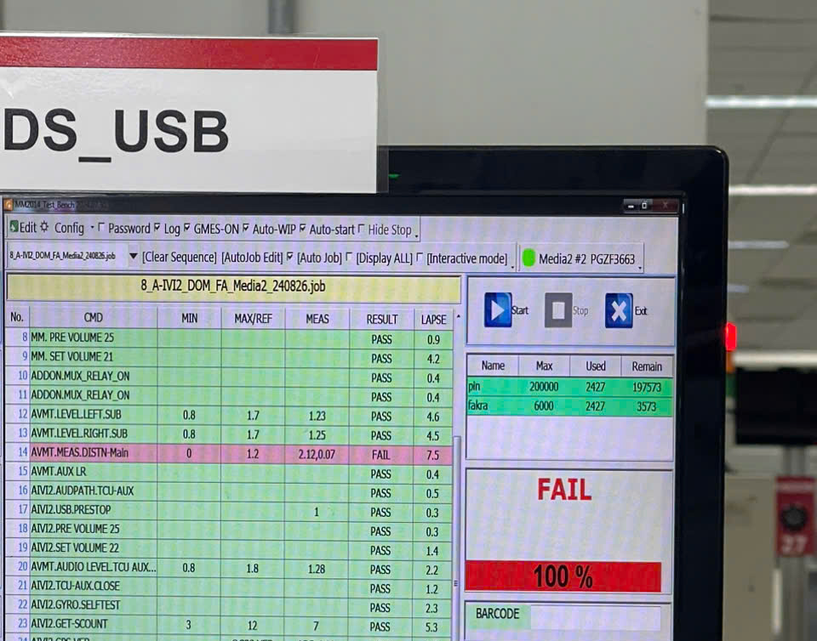
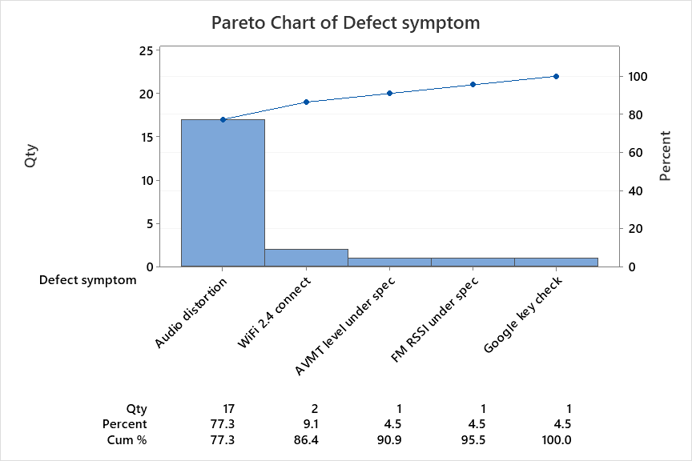
1. Pareto
Define
Measure
Analyze
Improve
Control
1.1 Define Issue
Issue information
Symptom : Reduce distortion of USB audio signal on Renault AIVI2
Prod Q’ty : 361
Defect Q’ty : 17
Defect Rate : 47,091 ppm
Issue date : 19.Jun.2025~17.July.2026
Reason of choosing
This issue occurs with high defect rate
I choose this item because high NG occurs frequently, UPH will be reduced
1.2 Defect Rate
Distortion of USB audio signal
+ Spec : 0 ~ 1.2
+ Actual : 0.01 ~ 2.2
Defect symptom | Qty (EA) | %
Audio distortion | 17 | 77.3%
Wifi 2.4 connect | 2 | 9.1%
FM RSSI under spec | 1 | 4.5%
AVMT level under spec | 1 | 4.5%
Google key check | 1 | 4.5%
Total | 22 | 100%
Notes:
I see that first issue is high portion, it uses high about 76 percent. The line is happen issue so I wanna improve this issue

Slide 4
2. Yy break down
Define
Measure
Analyze
Improve
Control
Big Y
Little y1
Little y2
Little y3
Activity
PIC
Reduce AIVI2
defect rate
Sorfware defect
Media 2 issue
Audio distortion issue
6 Sigma assignment
LD IE
Function issue
Wifi connect
Improve program
HQ R&D
Hardware defect
Vision inspection
OK/NG
Broken pin connector check PCBA
Supplier
Hardware defect
Appearance issue
Gap issue
Material defect → return to supplier
Supplier
Press issue
Machine issue
PE

Slide 5
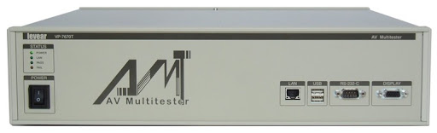
1. Preparation of Gage R&R
Measure
Define
Analyze
Improve
Control
Model: RENAULT AIVI2
Part name:
Measure System
How to get sample (sampling)
Equipment: Audio Video Multi Tester (AVMT)
Resolution: 0.01
Sample Selection:
Type 1: 1 people measure a sample, measure repeat 30 times
Type 2: 3 operators measure 10 samples, measure repeat 3 times (Blind and random)
A sample which contains the entire spec or the dispersion of the process should be selected
- Normally ± 10 to 20% is recommended, but it should be selected considering the current state of the goods in stock!
- The choice of sample should reflect the state of the process
- Pick NG/OK samples, including sample near spec.
4. Blind test: The measurer should not know the information of the
sample to be measured, including the specifications.
5. Random: The measuring sequence of the measurer and the sample to be measured and the repetition are determined randomly

Slide 6
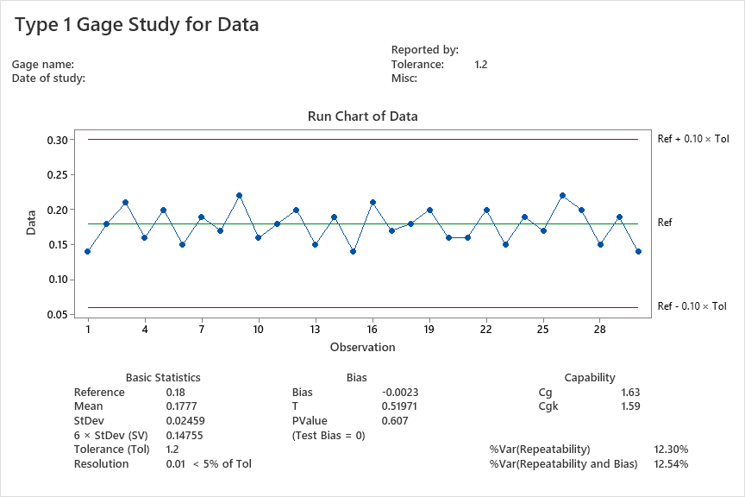
2. Result of Gage Study
Measure
Define
Analyze
Improve
Control
2.1. Type 1 Study
Reference | 0.18
Operator | QC member
Time | Data
1 | 0.14
2 | 0.18
3 | 0.21
4 | 0.16
5 | 0.20
6 | 0.15
7 | 0.19
8 | 0.17
9 | 0.22
10 | 0.16
11 | 0.18
12 | 0.20
13 | 0.15
14 | 0.19
15 | 0.14
16 | 0.21
17 | 0.17
18 | 0.18
19 | 0.20
20 | 0.16
21 | 0.16
22 | 0.20
23 | 0.15
24 | 0.19
25 | 0.17
26 | 0.22
27 | 0.20
28 | 0.15
29 | 0.19
30 | 0.14
Result:
- StDev: 0.02459
- Tolerance: 1.2
6xStDev (SV): 0.14755
Capability
- Cg: 1.63 > 1.33
Cgk: 1.59 > 1.33
- Method: Choose 1 QC member who skill well, measure 1 part 30 times same measure method to verify the measurement system, look at chart, we see “Resolution: 0.001<5% of Tol” → Resolution of equipment is OK and Cg, Cgk >1.33 (OK)
- Conclusion: Equipment is OK and can use to measure and analysis.
Notes:
Trước khi phân tích nguyên nhân, nhóm thực hiện Type 1 Gage Study để đánh giá độ lặp lại và độ chệch của hệ thống đo AVMT Distortion. Một mẫu chuẩn có Reference bằng 0.02 được đo lặp lại 30 lần.
Trên Run Chart, tất cả kết quả đo đều nằm trong giới hạn Reference ±10% Tolerance và dao động quanh giá trị chuẩn, không xuất hiện điểm bất thường vượt giới hạn.
Kết quả Cg và Cgk đều bằng 3.93, lớn hơn tiêu chuẩn 1.33, cho thấy hệ thống đo có độ lặp lại tốt. Mean bằng Reference 0.0200, Bias bằng 0 và P-value bằng 1.000, lớn hơn 0.05, nên không phát hiện bias có ý nghĩa thống kê.
Vì vậy, hệ thống đo đạt Type 1 Gage Study và có thể tiếp tục thực hiện Type 2 Gage R&R.
Theo hướng dẫn của Minitab Type 1 Gage Study, Cg lớn hơn 1.33 cho thấy độ phân tán của phép đo đủ hẹp so với tolerance; Cg đánh giá repeatability, còn Cgk đánh giá thêm ảnh hưởng của bias.
StDev cho biết các kết quả đo phân tán xa giá trị trung bình đến mức nào.
Hiểu rất đơn giản:
Mean cho biết dữ liệu nằm ở vị trí trung tâm nào.
StDev cho biết dữ liệu dao động rộng hay hẹp quanh Mean.
6 × StDev thường được dùng để biểu diễn độ rộng biến động tự nhiên của quá trình
Nếu dữ liệu gần phân phối chuẩn, khoảng 99.73% tổng thể nằm trong khoảng Mean±3sMean \pm 3sMean±3s

Slide 7
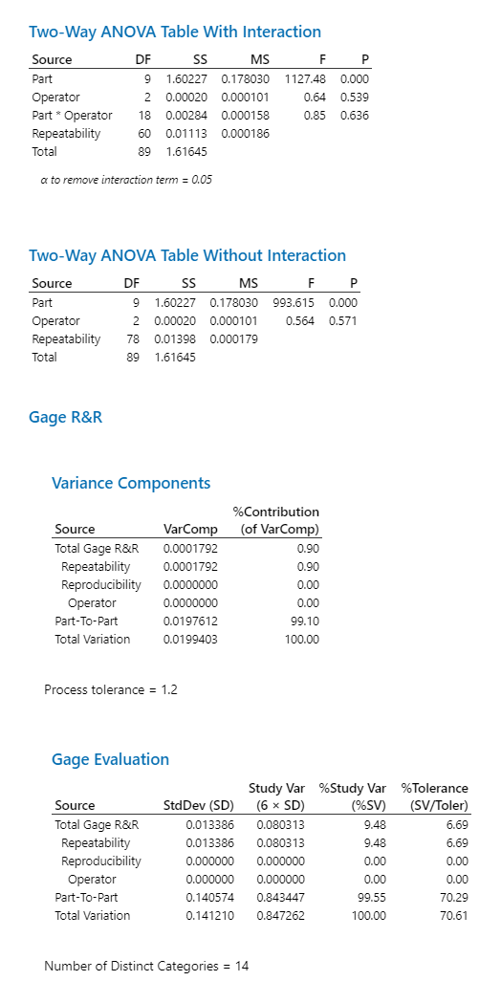
2. Result of Gage Study
Measure
Define
Analyze
Improve
Control
2.2. Type 2 study
 | Hoang |  |  | Long |  |  | Duc
 | Time 1 | Time 2 | Time 3 | Time 1 | Time 2 | Time 3 | Time 1 | Time 2 | Time 3
1 | 0.24 | 0.26 | 0.25 | 0.23 | 0.23 | 0.24 | 0.26 | 0.24 | 0.23
2 | 0.05 | 0.04 | 0.05 | 0.04 | 0.05 | 0.05 | 0.06 | 0.05 | 0.05
3 | 0.33 | 0.35 | 0.32 | 0.32 | 0.33 | 0.36 | 0.34 | 0.35 | 0.33
4 | 0.03 | 0.02 | 0.01 | 0.02 | 0.01 | 0.05 | 0.02 | 0.06 | 0.04
5 | 0.15 | 0.18 | 0.17 | 0.16 | 0.17 | 0.15 | 0.18 | 0.17 | 0.16
6 | 0.43 | 0.44 | 0.45 | 0.43 | 0.46 | 0.48 | 0.45 | 0.43 | 0.44
7 | 0.08 | 0.09 | 0.07 | 0.07 | 0.08 | 0.06 | 0.09 | 0.06 | 0.08
8 | 0.13 | 0.15 | 0.14 | 0.12 | 0.13 | 0.13 | 0.14 | 0.16 | 0.13
9 | 0.05 | 0.04 | 0.03 | 0.03 | 0.07 | 0.06 | 0.05 | 0.03 | 0.04
10 | 0.26 | 0.28 | 0.25 | 0.26 | 0.27 | 0.29 | 0.28 | 0.25 | 0.27
P part = 0.000 < 0.05 - OK → The different between parts is significant
→ Since we selected 10 different parts, each part should be different
P operator = 0.539 > 0.05
→ It is normal that measurements should not be measured differently.
P part * operator = 0.636 > 0.05
→ It is normal that Interaction between Part and Operator not occur
which means that the measurement is not different between part & operator
Conclusion:
*3 people measure 10 samples, measure repeat 3 times (Blind and random)
% Study Var (SV) : 9.48 < 10 (%) → OK
→ Can use to check process variation.
% Tolerance (SV / Toler) : 6.69 < 10 (%) → OK
→ Can use to judge OK/NG
NDC: 14 > 5 → OK
Notes:
Start→Quality tool→Gage study→Gage run chart

Slide 8
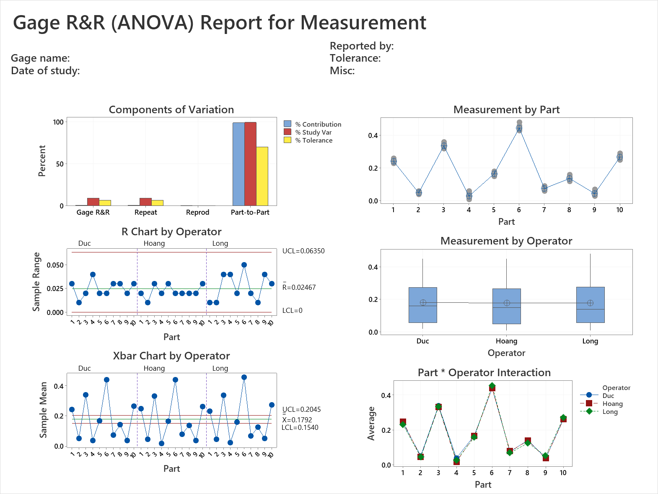
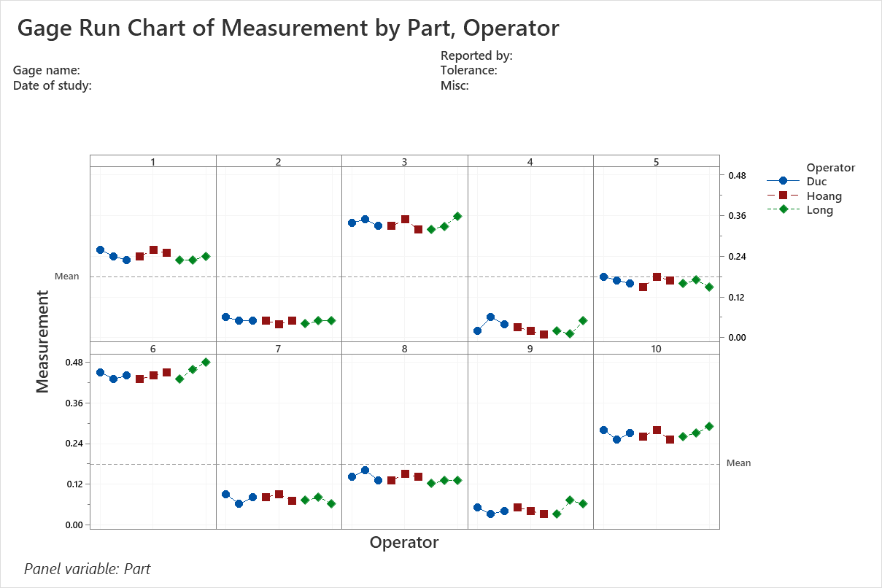
2. Result of Gage Study
Measure
Define
Analyze
Improve
Control
2.2. Type 2 study
Conclusion:
Based on interaction between samples and inspector, we cannot see significant differences between 10 samples.
Inspector’s skill is acceptable. There is no significant differences between 3 operators during each measurement time.

Slide 9
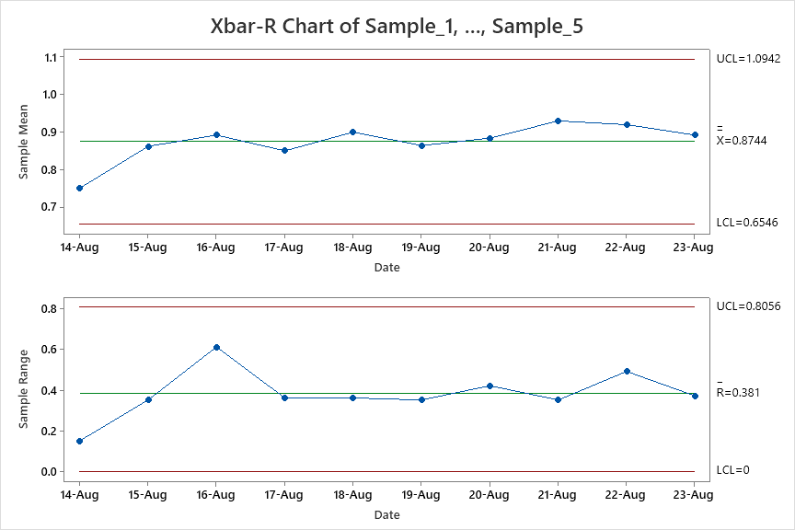
2. Result of Gage Study
Measure
Define
Analyze
Improve
Control
2.3. Xbar-R Chart Review
Issue Name: Reduce distortion of USB audio signal on Renault AIVI2
Spec: 0 ~ 1.2
Inspection Period: 14-08-2026 ~ 23-08-2026
Date | Sample_1 | Sample_2 | Sample_3 | Sample_4 | Sample_5
14-Aug | 0.68 | 0.74 | 0.83 | 0.71 | 0.79
15-Aug | 0.86 | 0.95 | 1.04 | 0.77 | 0.69
16-Aug | 0.73 | 1.31 | 0.81 | 0.91 | 0.7
17-Aug | 0.76 | 0.89 | 0.72 | 1.08 | 0.8
18-Aug | 0.94 | 0.75 | 1.11 | 0.82 | 0.88
19-Aug | 0.71 | 1.06 | 0.84 | 0.97 | 0.74
20-Aug | 0.79 | 0.92 | 1.14 | 0.72 | 0.85
21-Aug | 1.03 | 0.77 | 0.9 | 1.12 | 0.83
22-Aug | 0.78 | 1.01 | 0.86 | 1.22 | 0.73
23-Aug | 0.91 | 0.82 | 1.07 | 0.7 | 0.96
Sampling method :
Rational subgroup sampling
5ea/line /day/at LG line
Conclusion:
No out-of-control signal. However, AVMT Distortion remains high and NG samples still exceed the USL of 1.20.
→ Process is stable but not capable.
11/38
Notes:
Variances are subject to quality control and improvements !!!
1. How to process Type I? We need to measure 30 times for one sample which reference value is known
How to choose Sampling? Chọn mẫu như thế nào? Just choose random sample and know the reference value-
1 mẫu ngẫu nhiên biết trước reference value
2. How to get the reference value? Làm sao để có reference value?
There are two ways: Hai cách:
- First: Use equipment has high precision (accuracy) Sử dụng thiết bị đo chính xác cao.
- Second: Measure one sample 10 times with equipment has high precision then get mean (average) of these measured values. Đo lặp lại part 10 lần với 1 dụng cụ đo chính xác, sau đó lấy trung bình
3. Cg, Cgk là gì? Cg and Cgk are Measuring capacity index of measuring equipment --- Chỉ số năng lực đo đạc của thiết bị đo Tiêu chuẩn: Cg, Cgk >=1.33 4.
Phân biệt giữa Cg vs Cgk? Cg is used when target and data mean are the same, Cgk is used in case target and data mean is not the same.
5. Công thức của Cg &Cgk? Cp and Cpk are called Process Capability. Pp and Ppk are called Process Performance The index takes into consideration the fact that your data is maybe not centered.
How many method to select sample? Simple random Stratified Systematic Cluster Combination Tiêu chuẩn resolution <5% lấy đâu ra? –Based on the standard of GM, Bosch, VDA 5 The acceptance criteria are less than 5% in GM, Bosch, … and less than 10% in AIAG, so the resolution of the instrument is satisfactory. Tolerance=T=USL-LSL %RE=RE/T

Slide 10
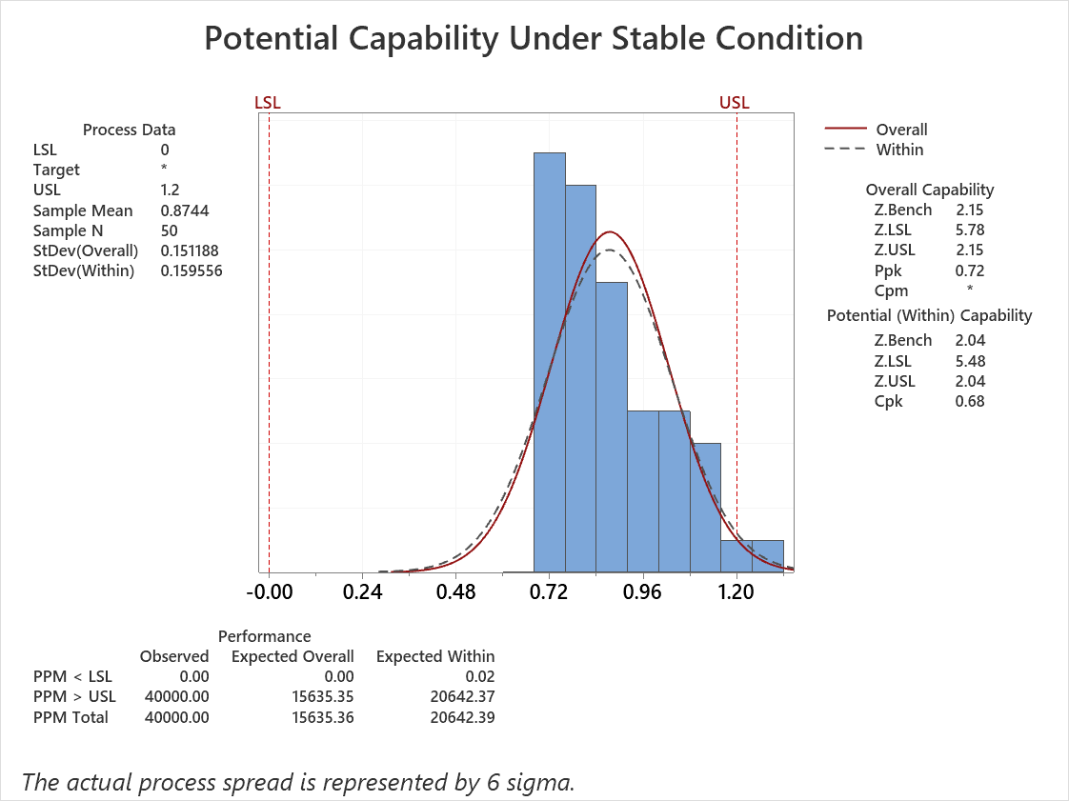
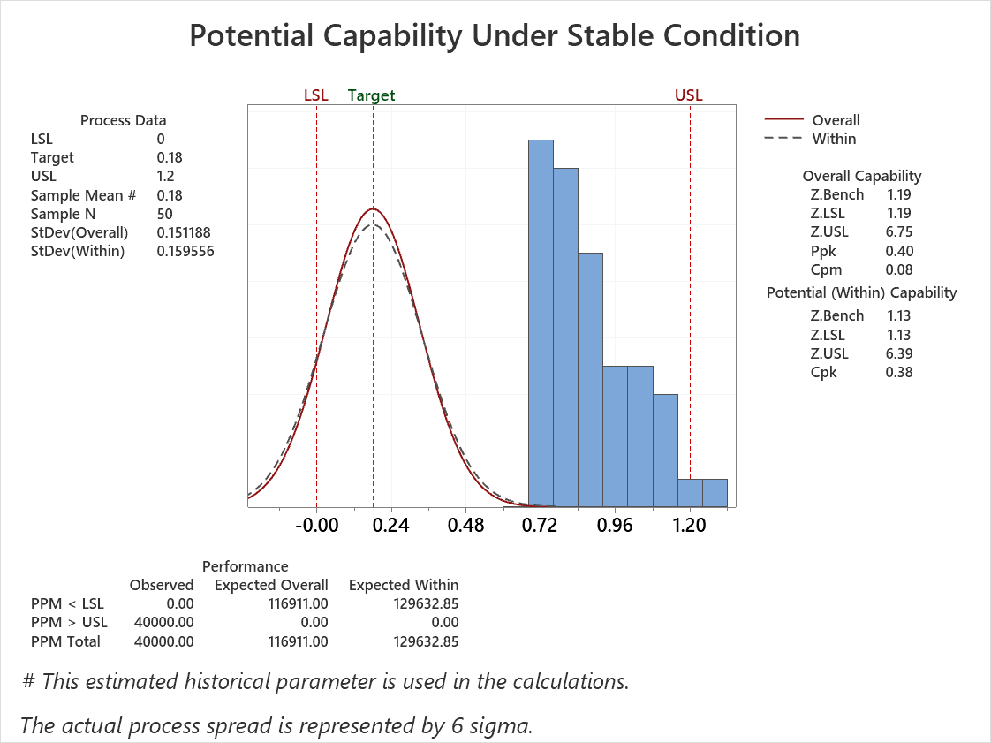
2. Result of Gage Study
Measure
Define
Analyze
Improve
Control
2.4. Result of current Cpk
Current Cpk
• Current process capability: Cpk = 0.68 < 1.33
→ The current process is not capable of consistently meeting the specification.
• The process mean is 0.8744, which is shifted toward the USL (1.20).
→ Approximately 4.0% of the observed results exceed the USL.
• Process centering and variation reduction are required.
→ Improvement actions should focus on reducing Distortion and shifting the process mean toward the target.

Slide 11
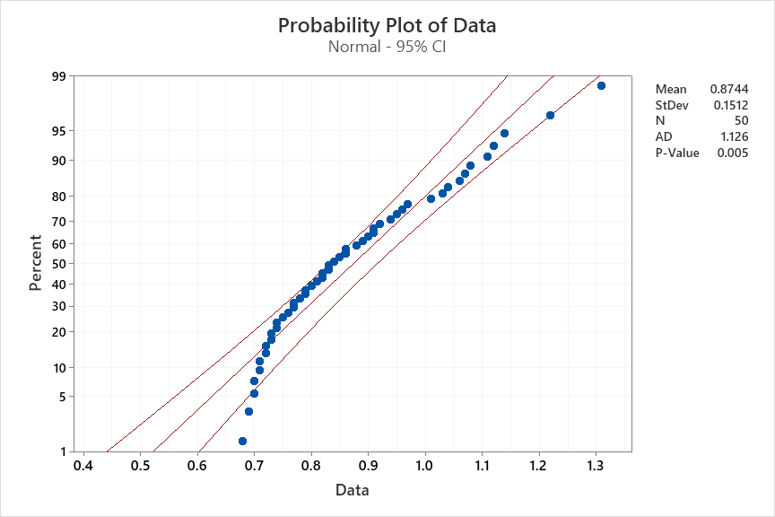
2. Result of Gage Study
Measure
Define
Analyze
Improve
Control
2.5. Process Capability review & Normality test
P value = 0.0005 ≤ 0.05 → NG
(Data not follow a normal distribution)
Cpk = 0.68 → Standard ≥ 1.33 → NG
→ Lack of process capability

Slide 12
3. Find the Root Cause that making distortion issue
Analyze
Define
Measure
Improve
Control
3.1. Logic tree analysis
Power supply is unstable

Power supply
Separate DC power from test bench
Machine
Conveyor and Pallet Contact
Unstable contact between Pogo Pins and Pogo Plates

Adjust Pogo Pin and pallet contact position
Measure incorrectly due to noise
Separate ground for each equipment
Audio Video Multi Tester
Accuracy is bad
Audio Video Multi Tester is calibrated frequently → OK
Audio distortion
Method
Job file sequence
Test AUX before USB test lead to temporary distortion

Change the sequence test between USB test & AUX test
Material
Set
Set is no problem
Plug in set to pallet not fully
If not plug in set fully, previous inspection will be fail
Not relate to set plugging in
Man
Working skill
Automatic process
Man is not related

: Potential factor

Slide 13
3. Find the Root Cause that making distortion issue
Analyze
Define
Measure
Improve
Control
2 Samples T test
No | Potential Factors | What is looking for ? | Tool to identify
1 | Power supply | Separate power supply from test bench to improve power quality | 2 sample T test
2 | Conveyor and Pallet Contact | Alignment & fix the contact level of Pogo pin with Pallet | 2 sample T test
3 | Job file sequence | Change the sequence of job file – move USB test before AUX test | 2 sample T test
Notes:
Ghi thông số

Slide 14
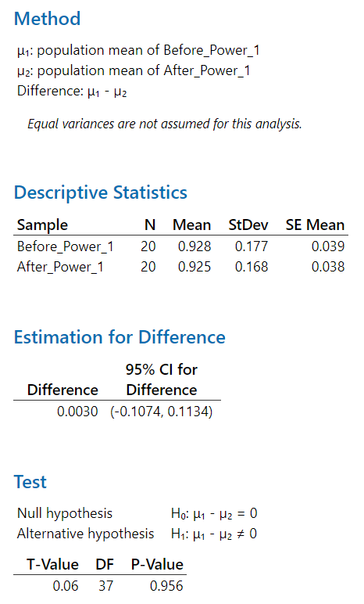
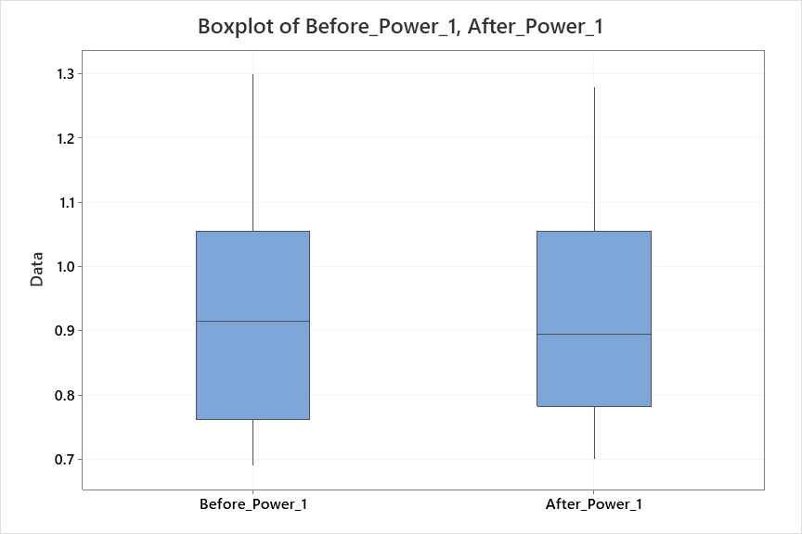
3. Find the Root Cause that making distortion issue
Analyze
Define
Measure
Improve
Control
2 Samples T _ Analysis for 2 case
Separate power supply from test bench to improve power quality
No | Before_Power | After_Power
1 | 0.69 | 0.70
2 | 0.95 | 0.93
3 | 0.84 | 0.82
4 | 1.04 | 1.06
5 | 0.76 | 0.78
6 | 1.19 | 1.18
7 | 0.90 | 0.88
8 | 1.11 | 1.09
9 | 0.77 | 0.79
10 | 0.99 | 1.01
11 | 0.74 | 0.72
12 | 1.30 | 1.28
13 | 0.86 | 0.87
14 | 1.06 | 1.04
15 | 0.75 | 0.77
16 | 1.02 | 1.00
17 | 0.81 | 0.83
18 | 1.16 | 1.14
19 | 0.93 | 0.91
20 | 0.70 | 0.71
Conclusion : we chose 20 samples before improving and 20 samples after improving
H0: Separate power supply from test bench action not effect to distortion
H1: Separate power supply from test bench action effect to distortion
P value = 0.956 ≥ 0.05 → Fail to reject H0
→ The charts showed that measurement values have no different between before samples and after samples

Slide 15
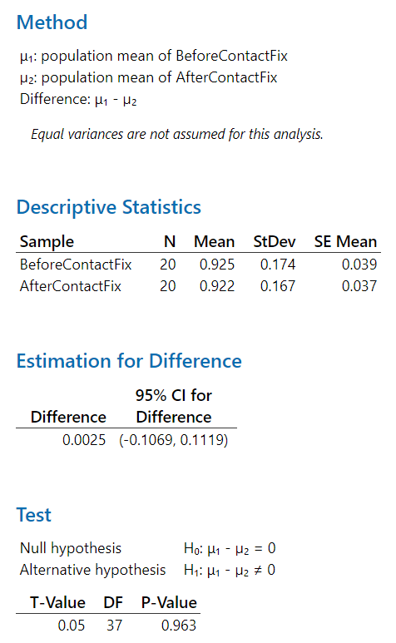
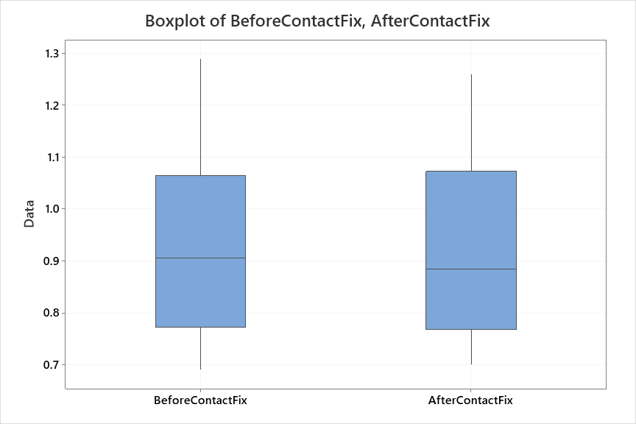
3. Find the Root Cause that making distortion issue
Analyze
Define
Measure
Improve
Control
2 Samples T _ Analysis for 2 case
Alignment & fix the contact level of Pogo pin with Pallet
No | BeforeContactFix | AfterContactFix
1 | 0.71 | 0.73
2 | 0.96 | 0.94
3 | 0.82 | 0.84
4 | 1.07 | 1.05
5 | 0.75 | 0.76
6 | 1.18 | 1.17
7 | 0.89 | 0.87
8 | 1.10 | 1.12
9 | 0.78 | 0.79
10 | 0.98 | 0.96
11 | 0.73 | 0.72
12 | 1.29 | 1.26
13 | 0.85 | 0.86
14 | 1.05 | 1.08
15 | 0.77 | 0.75
16 | 1.01 | 1.00
17 | 0.80 | 0.82
18 | 1.15 | 1.13
19 | 0.92 | 0.90
20 | 0.69 | 0.70
Conclusion : we chose 20 samples before improving and 20 samples after improving
H0: Alignment & fix the contact level of Pogo pin with Pallet not effect to distortion
H1: Alignment & fix the contact level of Pogo pin with Pallet effect to distortion
P value = 0.963 ≥ 0.05 → Fail to reject H0
→ The charts showed that measurement values have no different between before samples and after samples

Slide 16
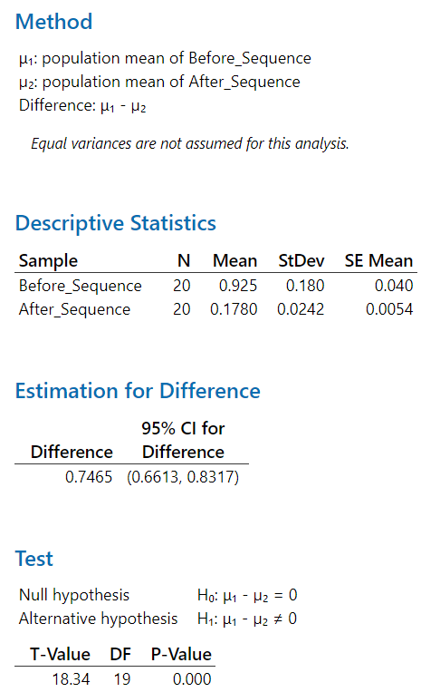
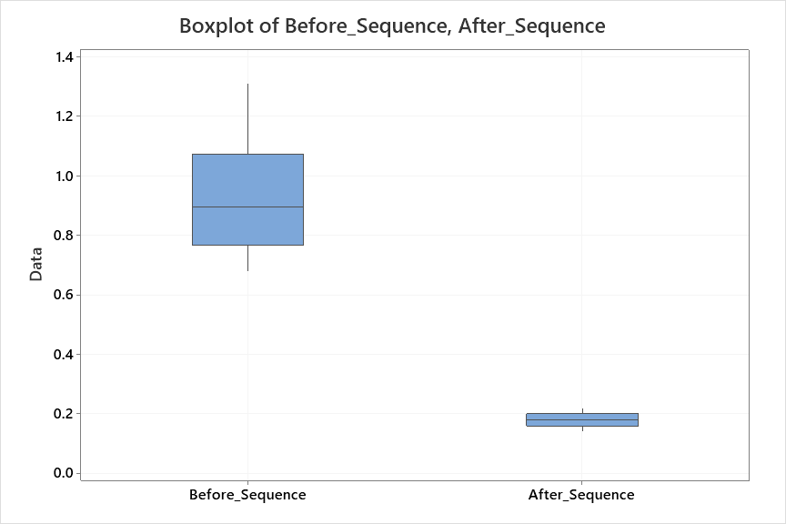
3. Find the Root Cause that making distortion issue
Analyze
Define
Measure
Improve
Control
2 Samples T _ Analysis for 2 case
Change the sequence of job file – move USB test before AUX test
No | Before_Sequence | After_Sequence
1 | 0.68 | 0.14
2 | 0.94 | 0.18
3 | 0.83 | 0.21
4 | 1.05 | 0.16
5 | 0.74 | 0.20
6 | 1.18 | 0.15
7 | 0.88 | 0.19
8 | 1.12 | 0.17
9 | 0.79 | 0.22
10 | 0.97 | 0.16
11 | 0.72 | 0.18
12 | 1.31 | 0.20
13 | 0.86 | 0.15
14 | 1.08 | 0.19
15 | 0.76 | 0.14
16 | 0.99 | 0.21
17 | 0.81 | 0.17
18 | 1.17 | 0.18
19 | 0.91 | 0.20
20 | 0.70 | 0.16
Conclusion : we chose 20 samples before improving and 20 samples after improving
H0: Change the sequence in jobfile not effect to distortion
H1: Change the sequence in jobfile effect to distortion
P value = 0.000 ≤ 0.05 → reject H0
→ The charts showed that measurement values have different between before samples and after samples

Slide 17
3. Find the Root Cause that making distortion issue
Analyze
Define
Measure
Improve
Control
2 Samples T test
No | Potential Factors | What is looking for ? | Tool to identify
1 | Power supply | Separate power supply from test bench to improve power quality | 2 sample T test
2 | Conveyor and Pallet Contact | Alignment & fix the contact level of Pogo pin with Pallet | 2 sample T test
3 | Job file sequence | Change the sequence of job file – move USB test before AUX test | 2 sample T test

Conclusion: After change the sequence of job file, move USB test before AUX test
→ This factor effect to issue
Notes:
Add conclusion

Slide 18
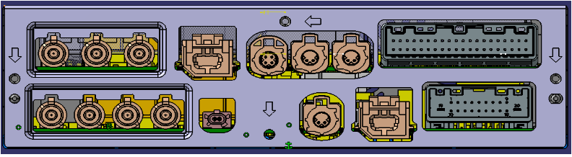

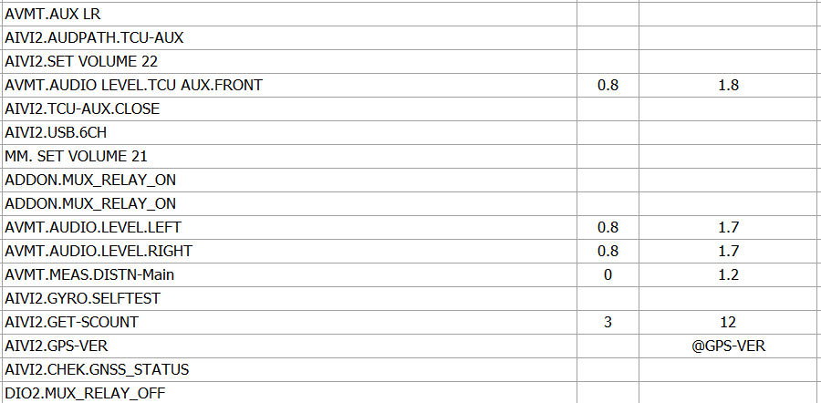
4. Improvement
Improve
Define
Measure
Analyze
Control
4.1. Short term
- USB quality was affect by the AUX test before which could lead to low value of sound quality & high distortion.
AV cable
Test PC
AVMT
LAN Cable
AVMT proceed measure the level each channel (RL, RR) and return result to Bench
AddOn BENCH
The measured level result was sent back to program
USB
AIVI2 SET
AVN BENCH
USB contain 1khz file will be played
USB
AUX Off
AUX typically uses an analog signal, which means it directly transmits electrical waveforms corresponding to the audio. USB, on the other hand, transmits a digital signal where audio is encoded in data packets.
Switching from AUX to USB might require the system to reconfigure its signal paths and reset certain components, which could lead to temporary distortion if not done properly.
USB Play
Notes:
Add conclusion

Slide 19
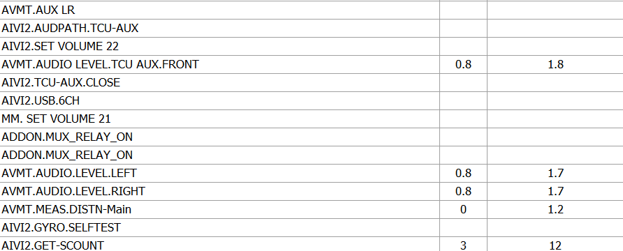
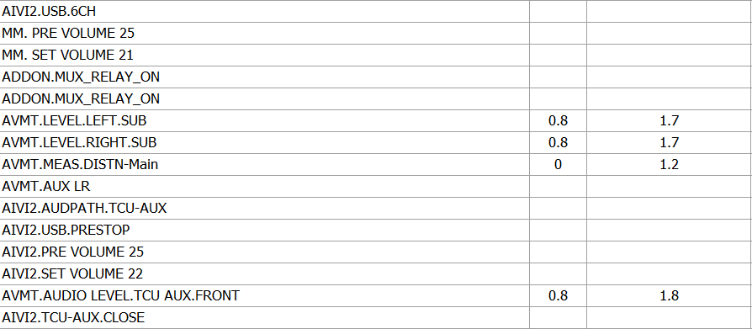
4. Improvement
Improve
Define
Measure
Analyze
Control
4.1. Short term
Action: Modify job file – change the sequence test between USB test & AUX test.
All the USB test function will be test first, and then AUX will be test after it.
Before
After
AUX Test
USB Test
USB Test
AUX Test
Notes:
Add conclusion

Slide 20
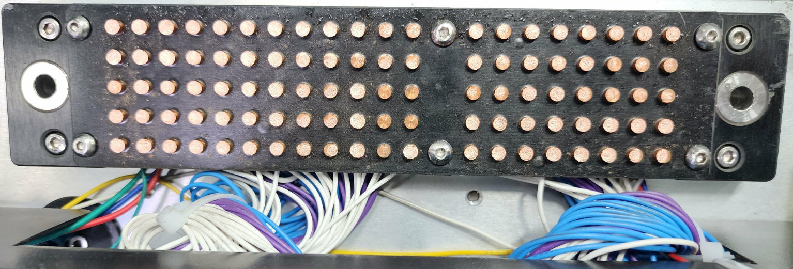
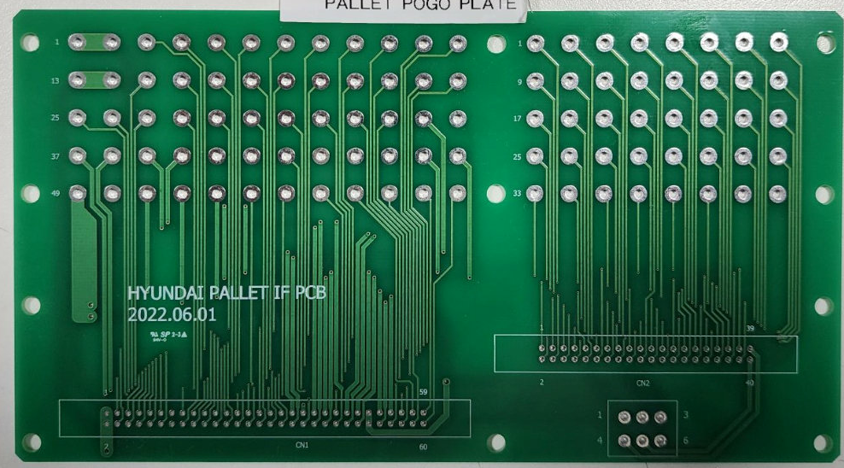
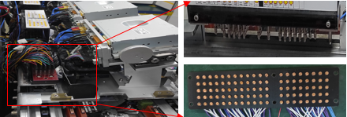
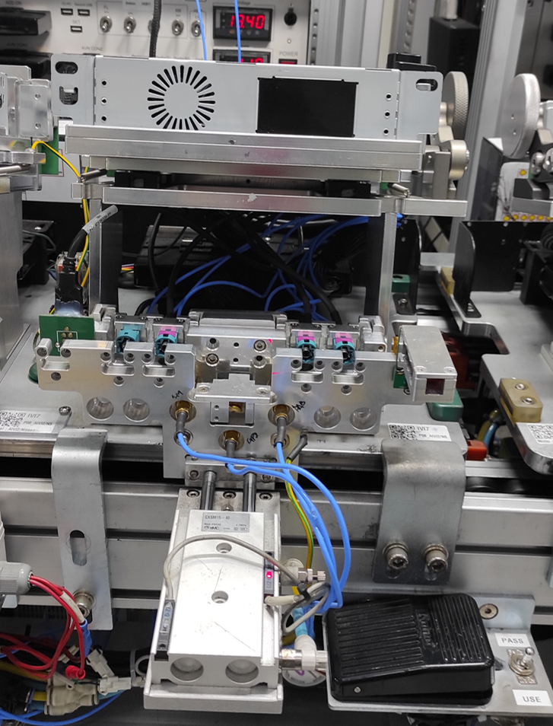
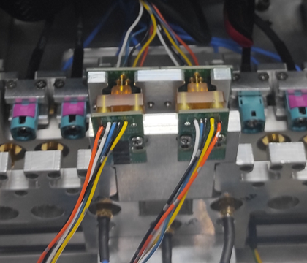
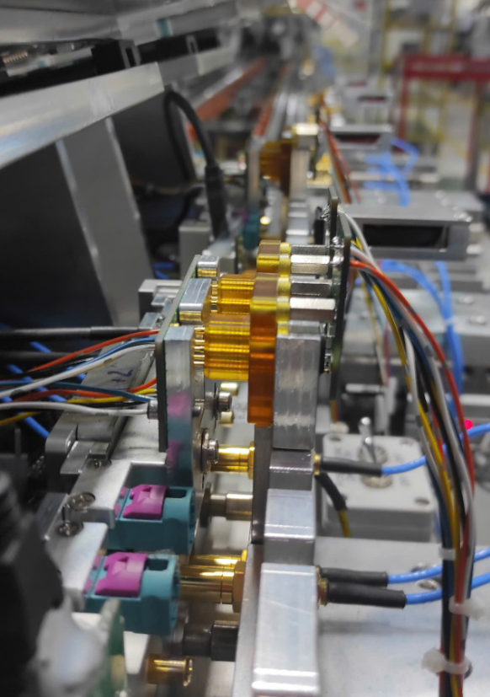
4. Improvement (long term)
Improve
Define
Measure
Analyze
Control
4.2. Long term
Action: Replace the old type of plate with new type for better contact point
Bad contact
Better contact
Action: Change connector type of audio signal from pogo pin block to PCB and connection direction (vertical to horizontal) to reduce force stress
Contact through pogo pin
Direct contact
Notes:
Add conclusion

Slide 21
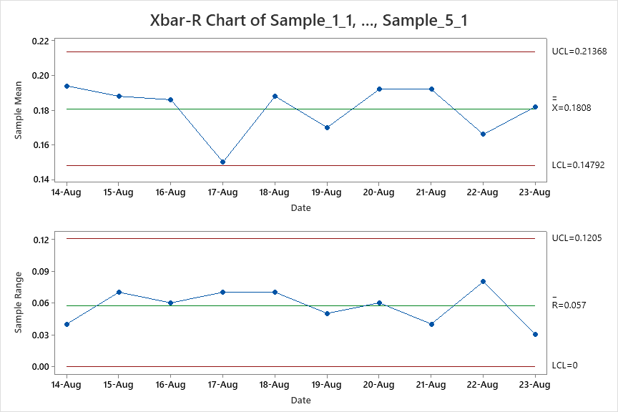
Improve
4. Improvement
Define
Measure
Analyze
Control
4.3. Xbar-R Chart Review
To monitor the mean and the variation of process after applying improvement and use control chart to monitor process stability over time.
- Sampling method: Rational sub group sampling firsts 5ea/day at production line for 10 days to analyze:
Date | Sample_1 | Sample_2 | Sample_3 | Sample_4 | Sample_5
24-Aug | 0.19 | 0.2 | 0.17 | 0.21 | 0.2
25-Aug | 0.17 | 0.2 | 0.22 | 0.15 | 0.2
26-Aug | 0.16 | 0.21 | 0.18 | 0.22 | 0.16
27-Aug | 0.13 | 0.19 | 0.15 | 0.12 | 0.16
28-Aug | 0.22 | 0.15 | 0.19 | 0.18 | 0.2
29-Aug | 0.14 | 0.18 | 0.17 | 0.19 | 0.17
30-Aug | 0.17 | 0.23 | 0.19 | 0.17 | 0.2
31-Aug | 0.19 | 0.21 | 0.21 | 0.18 | 0.17
1-Sep | 0.17 | 0.21 | 0.14 | 0.18 | 0.13
2-Sep | 0.17 | 0.2 | 0.17 | 0.2 | 0.17
Conclusion:
No abnormality can be found in the Xbar control chart and the R control chart. Therefore, stability is acceptable, the performance of process over time is Good

Slide 22
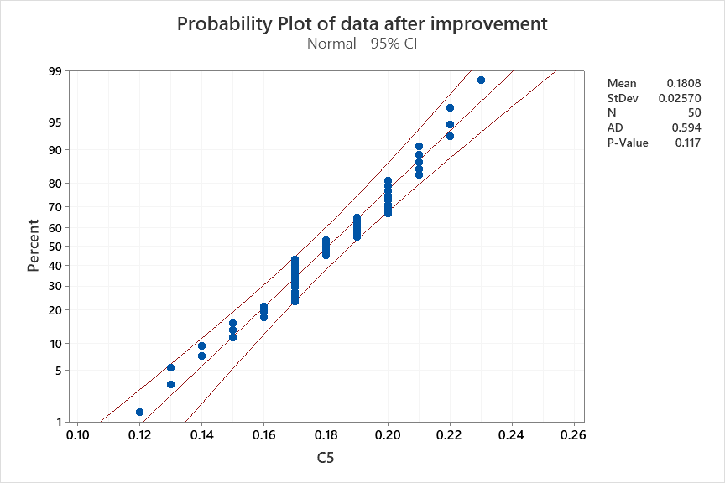
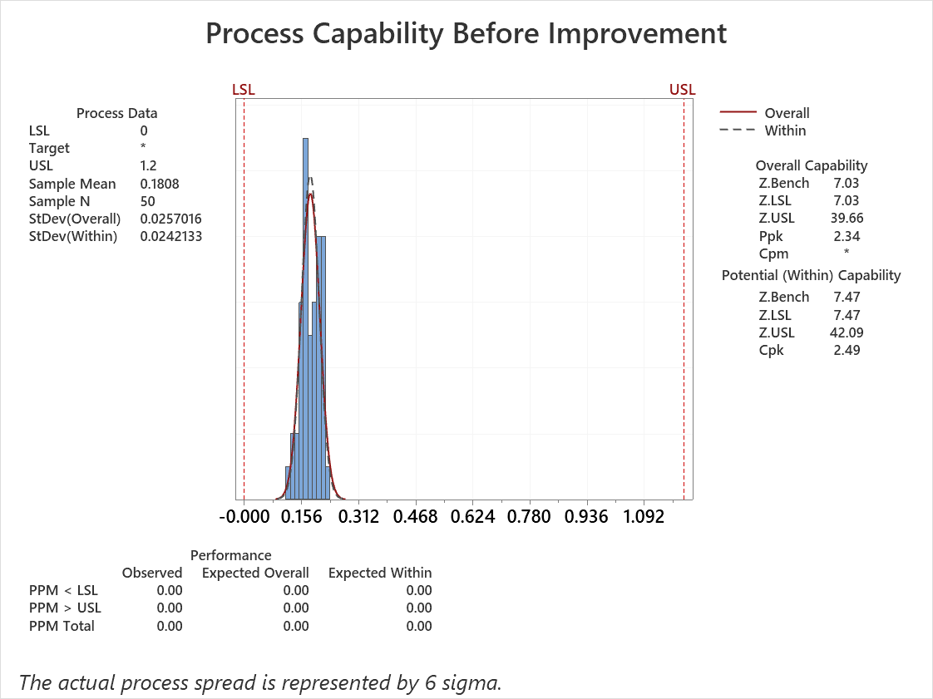
Improve
4. Improvement
Define
Measure
Analyze
Control
4.4. Process Capability review
Before
After
P-value = 0.005 < 0.05 → NG
(Data not follow a normal distribution)
P-value = 0.117 > 0.05 → OK
(Data follow a normal distribution)
Cpk = 0.68 → Standard: ≥ 1.33 → NG
Lack of process capability
Cpk = 2.49 → Standard: ≥ 1.33 → OK
Good process capability

Slide 23
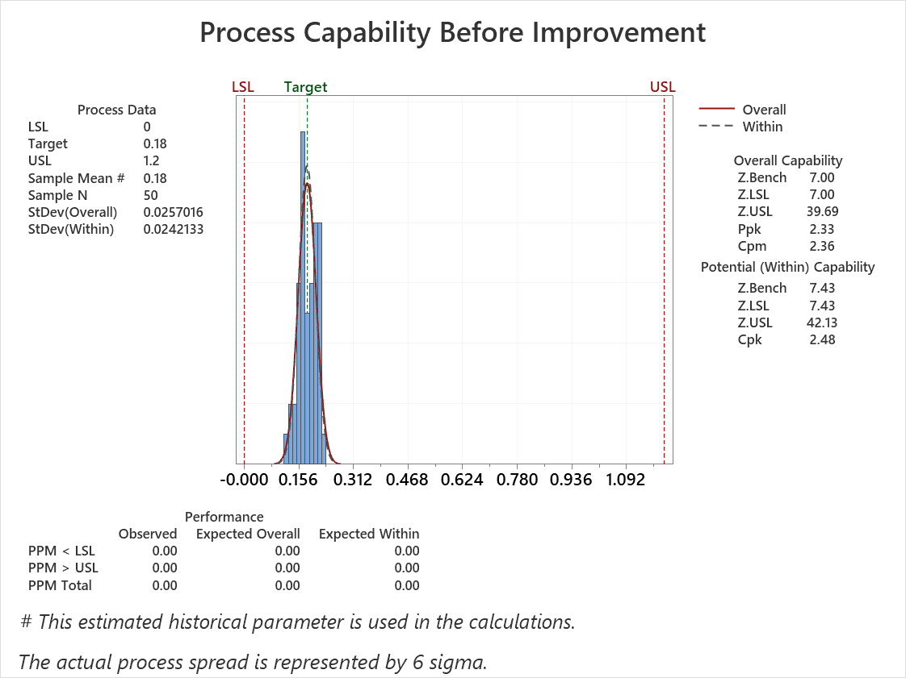
Improve
4. Improvement
Define
Measure
Analyze
Control
4.4. Process Capability review
Check the Z short term (best capability of process) and the Z long term (customer’s perspective):
Zshift = Zst – Zlt = 7.43 – 7.03 = 0.4 → Z shift < 1.5
→ Proper process control management
Z long term : 4.60 ≥ 4.5, Z short term: 4.67 ≥ 4.5
→ Technology is OK

Slide 24
Improve
4. Improvement
Define
Measure
Analyze
Control
4.5. Conclusion
After checking the current process, we found that the AVMT distortion values were widely dispersed and the process capability did not meet the requirement. Therefore, the identified process factor was suspected to be the main cause of the AVMT Distortion NG issue.
We implemented corrective actions on the identified factor. After improvement, the AVMT distortion data were collected again and evaluated using the Normality Test, Xbar-R Chart, and Process Capability Analysis.
The results show that the process mean decreased from 0.8744 to 0.1808, closely aligning with the target of 0.18. Cpk improved from 0.68 to 2.49, and no out-of-specification results were observed. Therefore, the improvement was confirmed to be effective, and the AVMT distortion process achieved stable and capable performance.

Slide 25
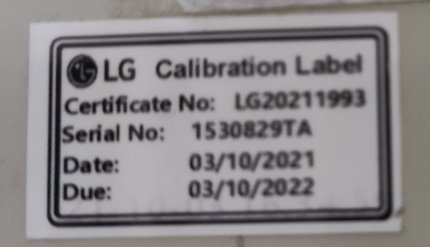
5. Control
Define
Measure
Analyze
Improve
Control
5.1. DMM equipment
Control by Nguyen Dang Quang (PM member) calibrated time is yearly
Main PIC | Nguyen Dang Quang (PM member)
Time calibration | Yearly
Equipment | DMM
Quantity | 2
5.2 Pallet
AVMT calibration label

